Slide 1
Image preprocessing
Need for Preprocessing
Noise reduction
Contrast enhancement
Image smoothening
Image resizing and scaling
Image rotation and alignment
Image normalization
Notes:
Nedd for preprocessing:
Noise reduction
Contrast enhancement
Image smoothing
Image resizing and scaling
Image rotation and alignment
Image normalization

Slide 2
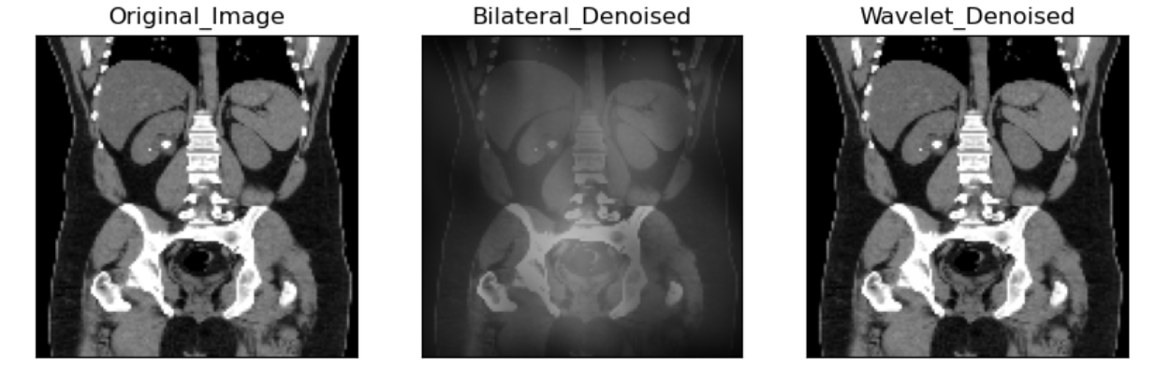
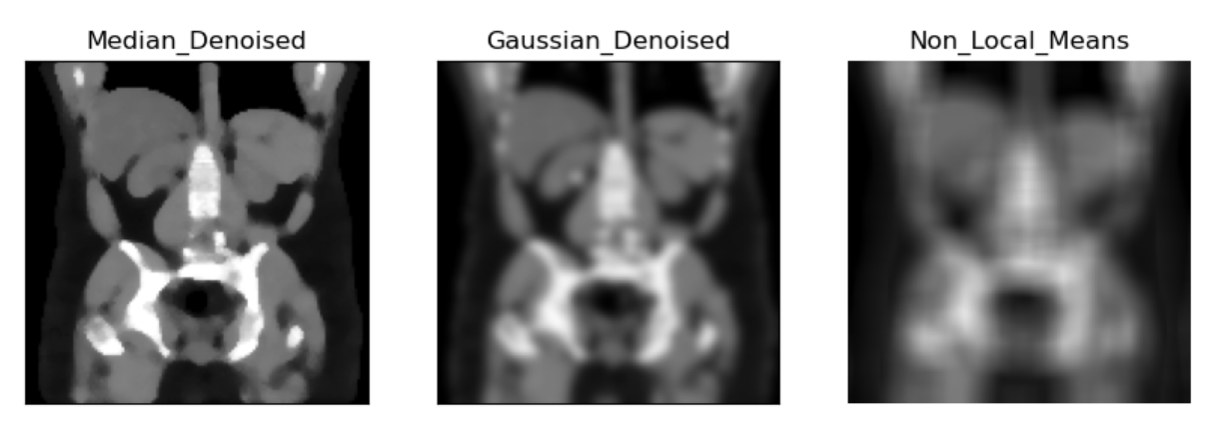
Preprocessing techniques for images:
Notes:
Techniwues
How to choose which one?
Trade off

Slide 3
Median Filtering def median_wholedataset(noised_dataset, filtersize, size): Gaussian Filtering def GaussianFilter_wholedataset(noised_dataset, sigma): Bilateral Filtering def BilateralFilter_wholedataset(noised_dataset, sigma_color, sigma_spatial, channel_axis, size):
Notes:
Median Filtering: Salt-and-pepper noise, spiky noise, preserving edges.
Gaussian Filtering: Smoothing, Gaussian noise, blurring.
Bilateral Filtering: Smoothing, preserving edges, fine details, spatial proximity, intensity similarity.

Slide 4
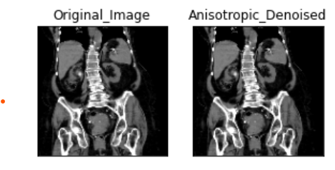
Anisotropic Filtering def AnisotropicFilter_wholedataset(noised_dataset, niter, kappa, gamma, option, size): Wavelet Denoising def wavelet_wholedataset(noised_dataset, sigma, wavelet_levels, size): Non-local Means Denoising def non_local_mean(image): OpenCV Bilateral Filter def cv2bilateralFilter(image, d, sigmaColor, sigmaSpace):
Notes:
Anisotropic Filtering: Medical images, microscopic images, preserving edges, specific applications.
Wavelet Denoising: Various types of images, wavelet transforms, frequency bands, image details.
Non-local Means Denoising: Textures, structures, redundancy, image content.
OpenCV Bilateral Filter: Smoothing, preserving edges, fine details, OpenCV library.

Slide 5
Metrics to check preprocessing efficiency:
SSID
measures the sum of squared differences between pixel intensities in two images.
MSE
measures the average of squared differences between pixel intensities in two images.
PSNR
measures the ratio of peak signal power to the noise power in an image.
Notes:
SSID (Sum of Squared Intensity Differences) is a metric used to evaluate the similarity or dissimilarity between two images. A lower SSID value indicates a higher similarity between the images.
MSE (Mean Squared Error) is another commonly used metric for image quality assessment. Similar to SSID, a lower MSE value indicates a higher similarity between the images.
Peak Signal-to-Noise Ratio (PSNR) is a metric used to quantify the quality of an image reconstruction or denoising process. It measures the ratio of the peak signal power to the noise power in an image. PSNR is often expressed in decibels (dB), and a higher PSNR value indicates a higher quality image.

Slide 6
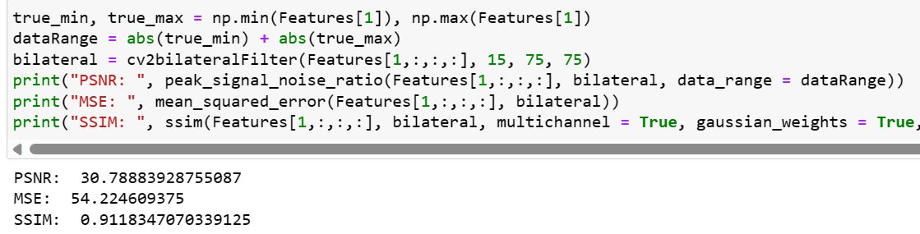
Notes:
SSID (Sum of Squared Intensity Differences) is a metric used to evaluate the similarity or dissimilarity between two images. A lower SSID value indicates a higher similarity between the images.
MSE (Mean Squared Error) is another commonly used metric for image quality assessment. Similar to SSID, a lower MSE value indicates a higher similarity between the images.
Peak Signal-to-Noise Ratio (PSNR) is a metric used to quantify the quality of an image reconstruction or denoising process. It measures the ratio of the peak signal power to the noise power in an image. PSNR is often expressed in decibels (dB), and a higher PSNR value indicates a higher quality image.

Slide 7
Steps we analysed:
Preprocessing
Segmentation
Feature extraction
Classification
Detection
Notes:
Preprocessing: Image preprocessing techniques such as noise reduction, image enhancement, and normalization can improve the quality and clarity of kidney stone images, making them easier to analyze.
Segmentation: Techniques like thresholding, region growing, or active contour models can be applied to segment kidney stones effectively.
Feature Extraction: Extracting relevant features from the segmented kidney stone regions can aid in characterization and classification. Features such as shape, texture, intensity, and size can provide valuable information for differentiating types of kidney stones.
Classification: Machine learning and pattern recognition algorithms can be employed to classify kidney stones based on their features
Detection and Localization: Once the kidney stones are segmented and classified, the precise detection and localization of stones within the kidney or urinary tract can be performed.

Slide 8
Conclusion
Image processing techniques play a crucial role in the detection of kidney stones.
By analyzing medical images such as X-rays or CT scans, image processing algorithms can enhance image quality, extract relevant features, and assist in the identification and diagnosis of kidney stones.

Slide 9
Improvements:
Adopt a better denoising technique and try for more accuracy.
Reduce epochs by better preprocessing.
Compare with other classifiers like k-means, Random forest , other neural network models.
Build confusion matrix for each and compare parrallely.

